Slide 1
Decision Tree

Slide 2
Decision Tree
模型的決策邊界： -100 + 6*溫度 + 3*濕度 = 0
-100 + 6*溫度 + 3*濕度 > 0 預測是一個美味的披薩
-100 + 6*溫度 + 3*濕度 < 0 預測是一個難吃的披薩
然而，奧客扭曲的品味實際是以下決策函數
-100 + 6*溫度² + 3*濕度³ + 20*溫度*濕度² + -70*溫度*濕度²*氣壓 + 0.001*濕度²*氣壓^重量+重量*R*溫度

Slide 3
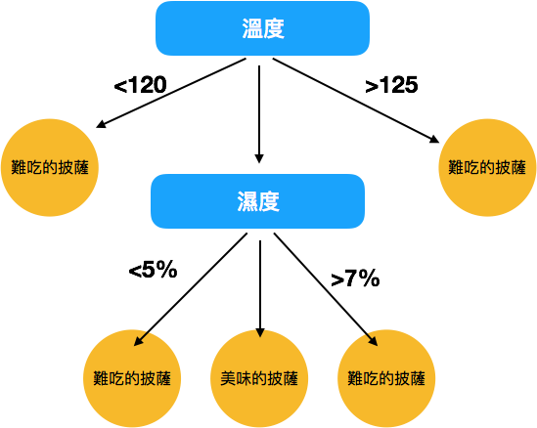
Decision Tree
https://medium.com/jameslearningnote/%E8%B3%87%E6%96%99%E5%88%86%E6%9E%90-%E6%A9%9F%E5%99%A8%E5%AD%B8%E7%BF%92-%E7%AC%AC3-5%E8%AC%9B-%E6%B1%BA%E7%AD%96%E6%A8%B9-decision-tree-%E4%BB%A5%E5%8F%8A%E9%9A%A8%E6%A9%9F%E6%A3%AE%E6%9E%97-random-forest-%E4%BB%8B%E7%B4%B9-7079b0ddfbda
Notes:
https://medium.com/jameslearningnote/%E8%B3%87%E6%96%99%E5%88%86%E6%9E%90-%E6%A9%9F%E5%99%A8%E5%AD%B8%E7%BF%92-%E7%AC%AC3-5%E8%AC%9B-%E6%B1%BA%E7%AD%96%E6%A8%B9-decision-tree-%E4%BB%A5%E5%8F%8A%E9%9A%A8%E6%A9%9F%E6%A3%AE%E6%9E%97-random-forest-%E4%BB%8B%E7%B4%B9-7079b0ddfbda

Slide 4
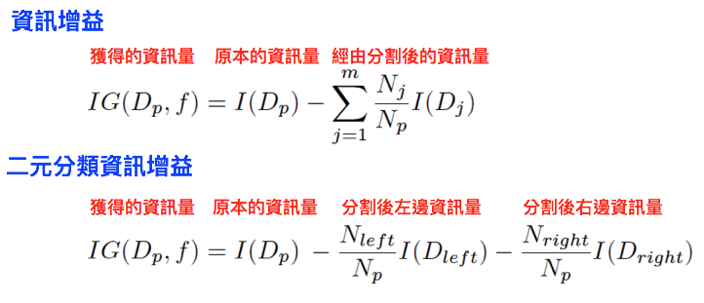
Decision Tree

Slide 5
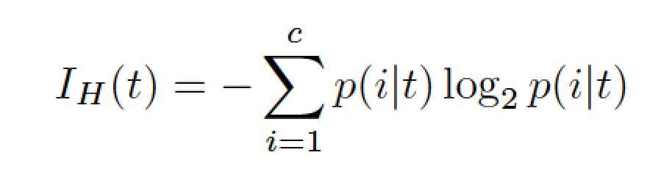
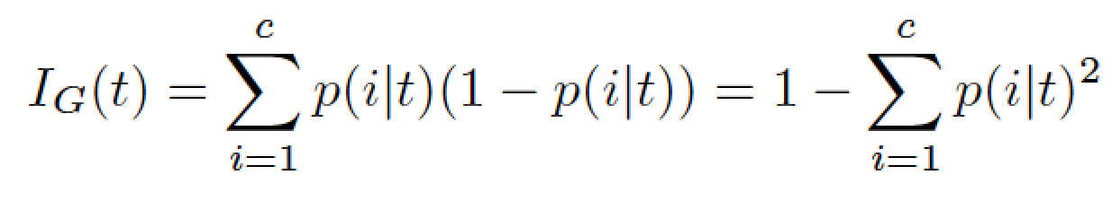
Decision Tree
熵(Entropy)
Gini不純度(Gini Impurity)

Slide 6
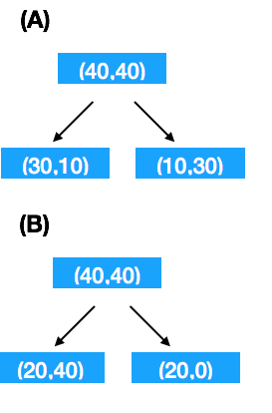
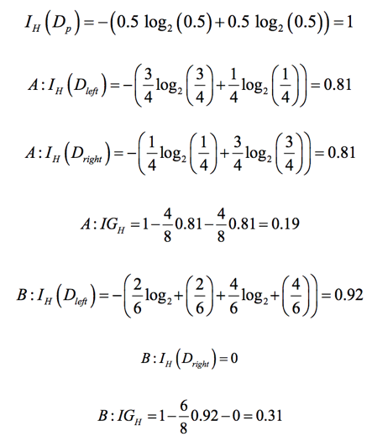
Decision Tree - Entropy

Slide 7
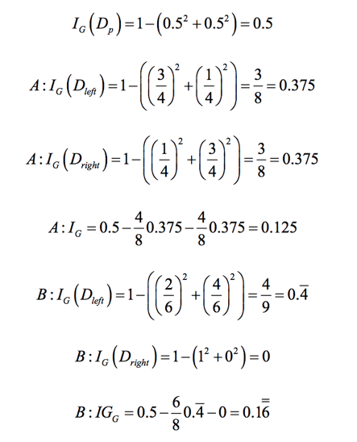
Decision Tree – Gini Impurity

Slide 8
Neural Decision Tree

Slide 9


